Slide 1

Tic tac toe: Cloudflare Worker Performance Optimization
Implementing DECOUPLED GAME LOGIC WITH Caching & Logging for Efficient Response Times

Slide 2
Agenda
Overview of the Assignment
Initial Design
Performance Issues Identified
Caching & Logging Optimization
Load Testing & Results
Key Takeaways

Slide 3
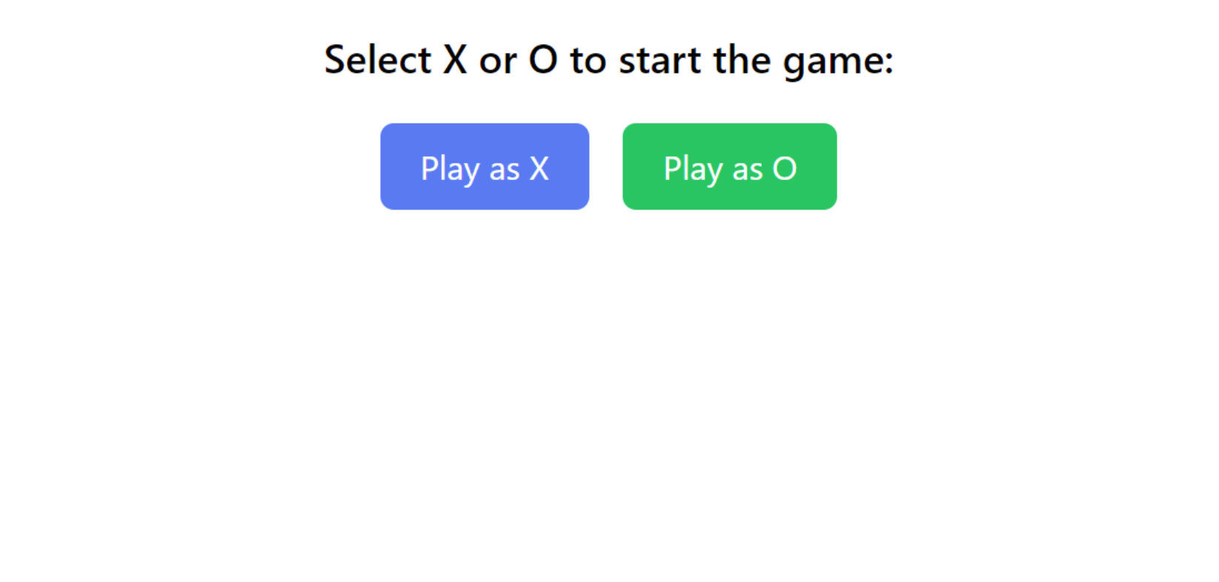
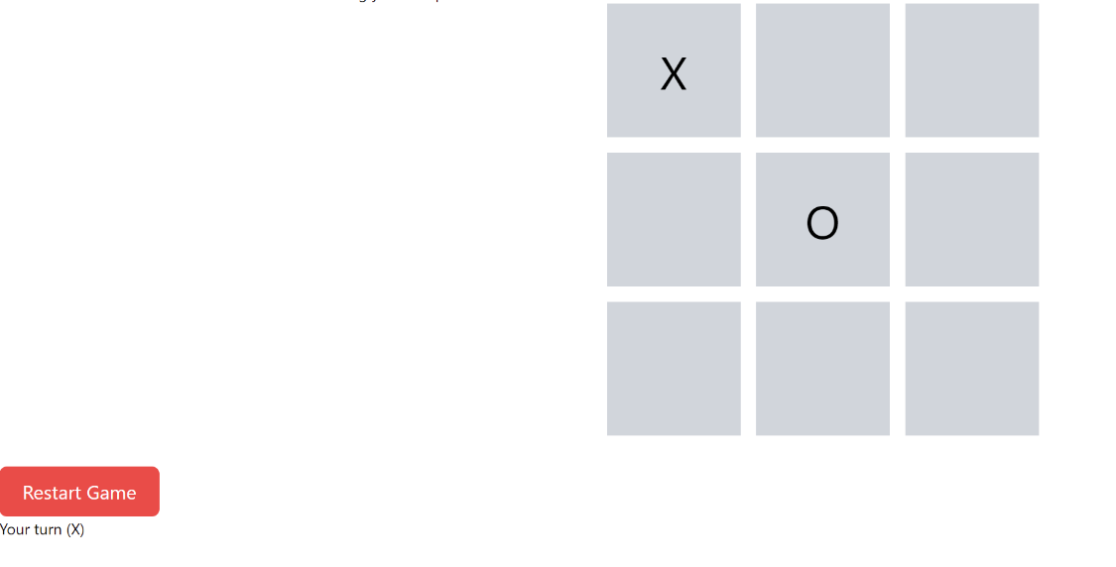
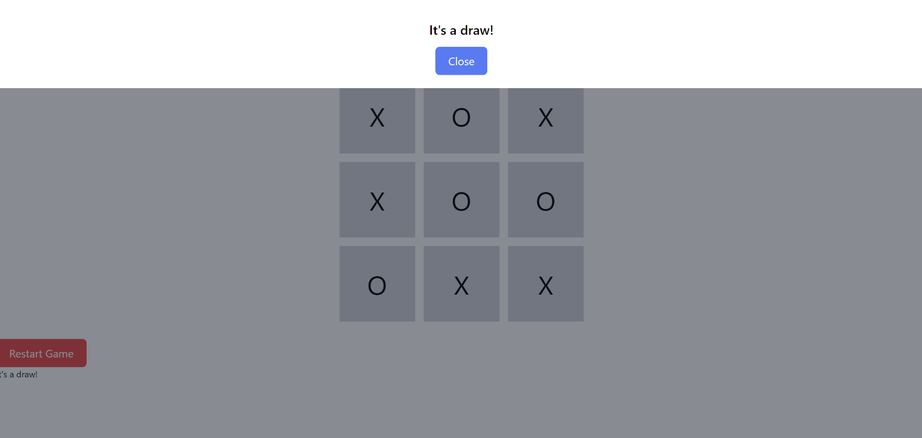
Game Views
User has option to play as X or O
Users can input their choice by clicking on tile. At any point in time users can click “Restart game” to restart
Results of winner displayed at end

Slide 4
Assignment
Objective: Implement a Cloudflare Worker to handle Tic-Tac-Toe moves with a (smart) adversary (AI).
Key Technologies:
Cloudflare Worker for serverless execution
KV Storage for caching
K6 for load testing
Challenges:
Ensuring low latency and scalable performance
Efficient request handling and reduced load on origin servers

Slide 5
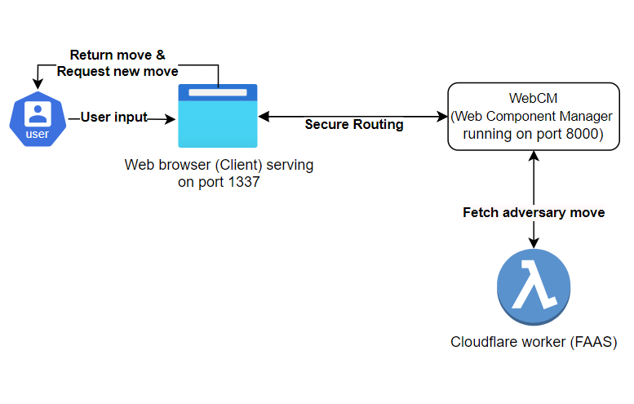
Initial Design
Requests handled directly by Cloudflare Worker without caching
AI move calculated on each request using Minimax or Random logic
All requests sent to origin server for AI move computation

Slide 6
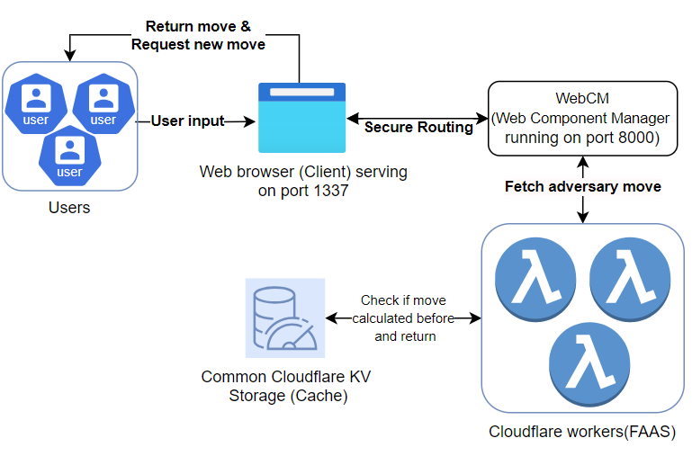
Final Design
Solution: Caching & Logging
Caching Strategy: Cache AI move results using Cloudflare KV for repeated requests
Reduce re-computation by fetching responses directly from cache
Logging: Add logs to monitor and debug request flow, caching behavior, and errors
Notes:
Having logs was useful for viewing if the cloudflare worker was able to access key value store and if the caching mechanism was working as expected. Are there hits or only misses that result in frequent recalculation. Without these logs I would have missed out a key caching failure that I was able to catch just in time.

Slide 7
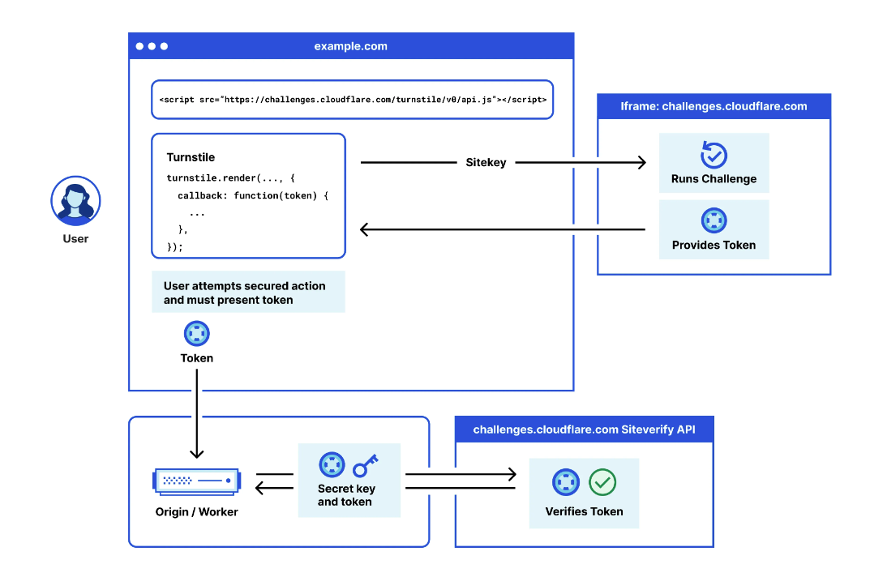
Notes:
https://developers.cloudflare.com/turnstile/
https://blog.cloudflare.com/end-cloudflare-captcha/
While I was crafting the design, I was also researching about cloudflare features and models and found that my final design had a striking resemblance to the turnstile feature architecture which is similar to the captcha technology we are all too familiar with. It also has a widget that is the challenge similar to the tictactoe and the website fetches the challenge and verificiaotin of challenge results from an origin server.

Slide 8
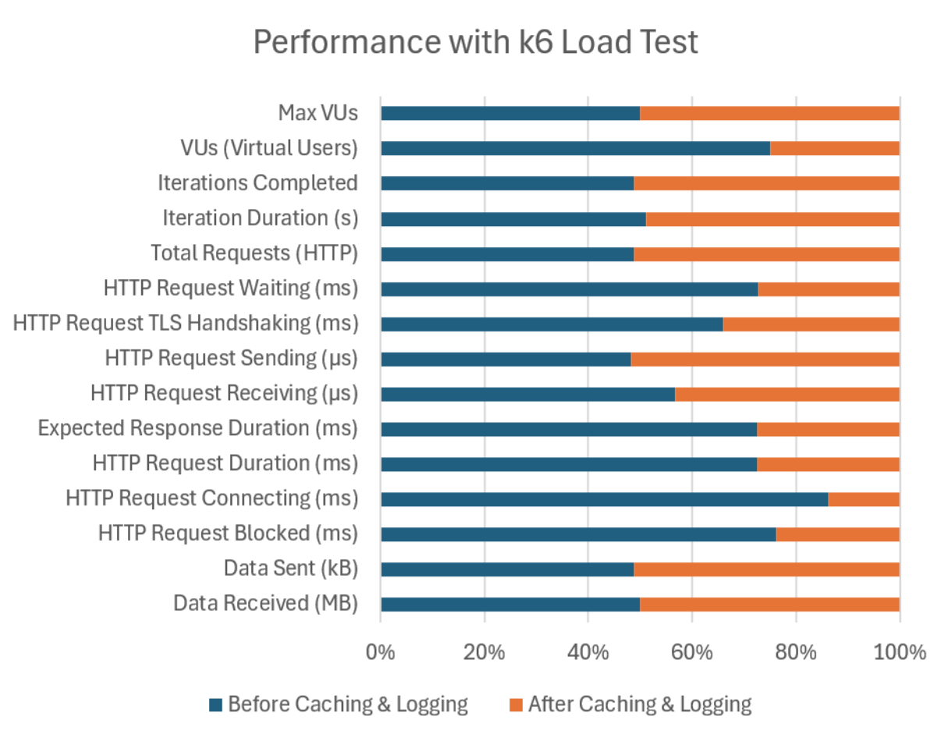
Load Testing Design
Tool Used: K6, a popular tool for load testing
Test Setup:
Load with 100 virtual users over 2 minutes
Measure request durations, connection times, and resource utilization
Results:
Reduced average request duration
Lower connection times and HTTP blocking
Increased total requests handled.
Key Metrics:
Avg Request Duration: Improved from 75.87ms to 28.81ms
HTTP Request Blocked: Improved from 2.57ms to 799.68µs
Total Requests: Increased from 5031 to 5274

Slide 9
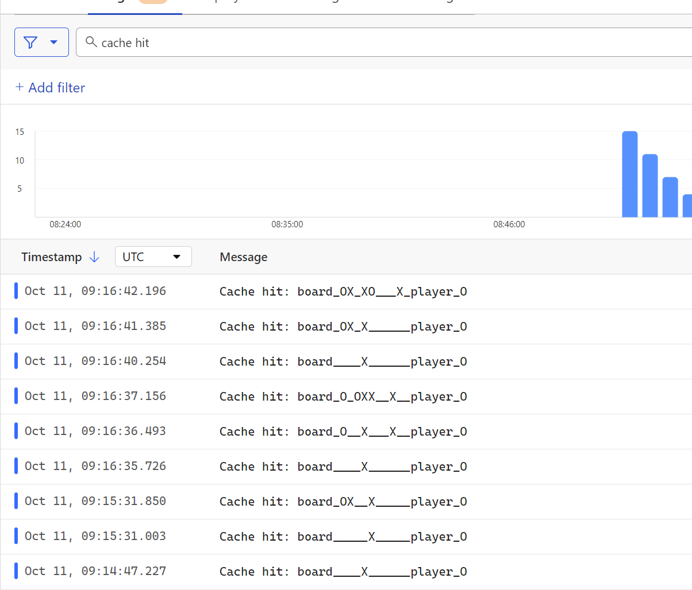
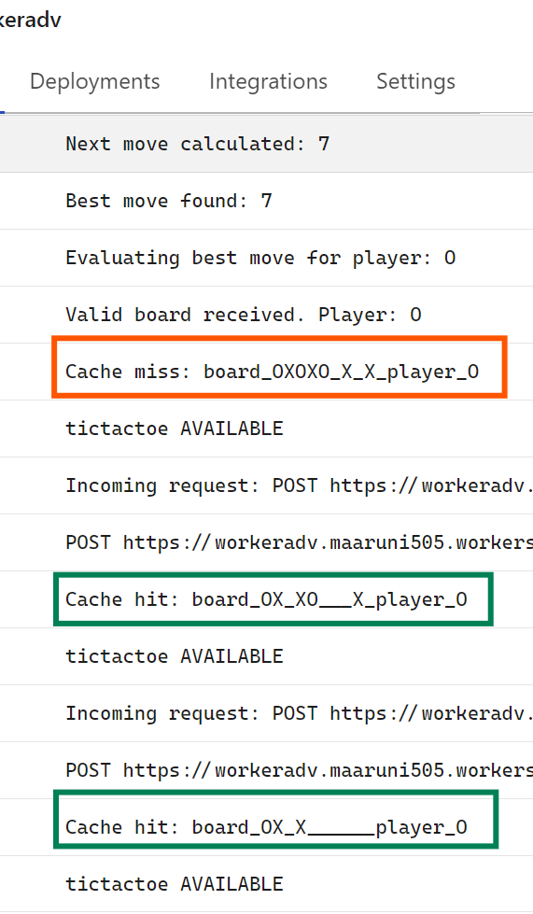
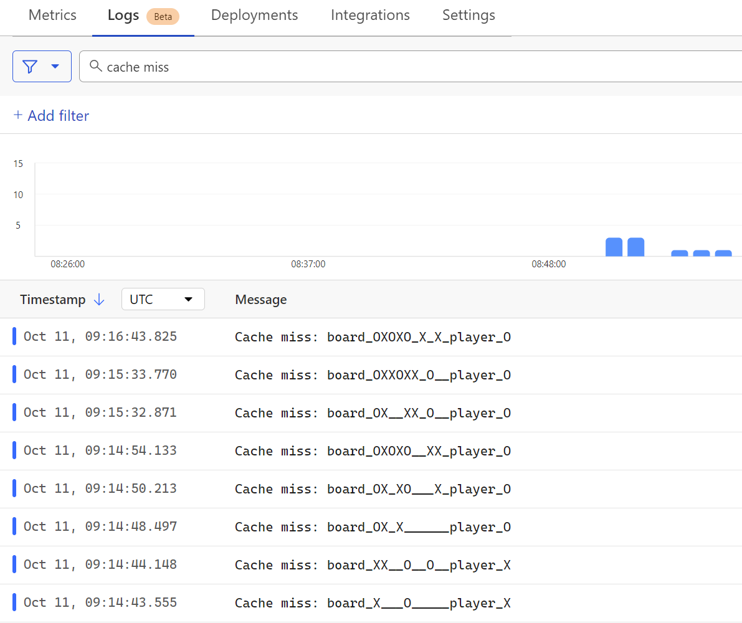
Load Testing & Logging
Caching Impact:
Drastically reduced computational overhead
Improved response times and request handling
Logging Impact:
Ensuring Cloudflare logs are securely only visible to developers to troubleshooting
Scalability:
Cloudflare KV allows shared cache across distributed workers
Increased ability to handle high traffic with minimal delay
Lessons Learned:
Importance of caching in serverless architectures
Optimizing for performance by reducing redundant computations

Slide 10
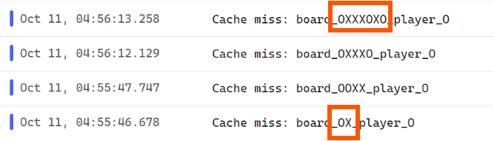
Challenges
Learning to use cloudflare worker and KV as cache
Understanding how MC components work under the hood
Designing proper cache key for tic tac toe use case
Good cache key design
2 different board positions will produce different accurate results as empty spaces accounted for
Poor cache key design
2 different board positions will produce same inaccurate result

Slide 11

Thank you!

